Slide 1








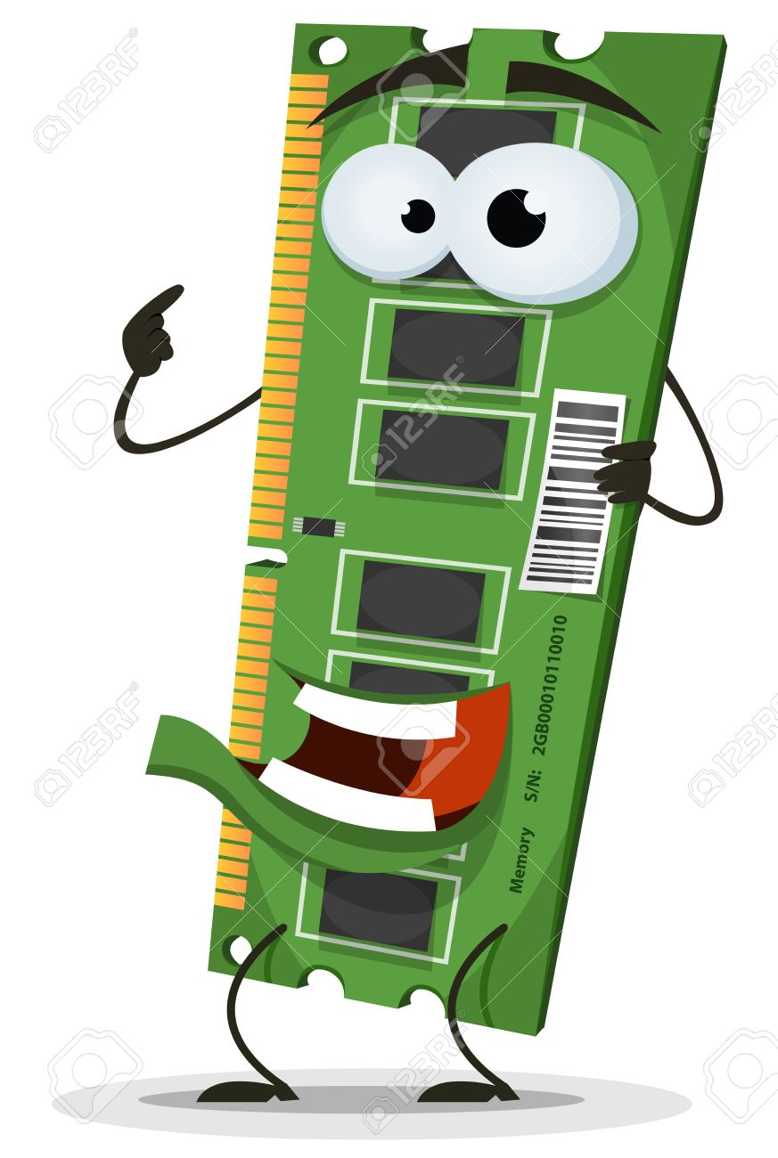





Spring 2021

Slide 2
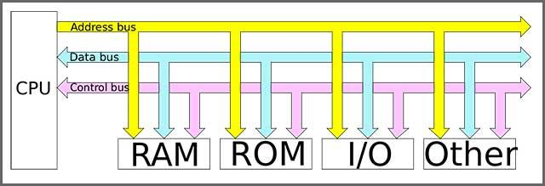
_____________
_/_|[][][][][] | - -
( City Bus | - -
=--OO-------OO--=dwb
Bus Review
A bus is basically a set of wires where information can be sent from one component to another
System bus:
Data bus runs in both direction and transmits data
Address bus carries the address of where to retrieve or store information
Control bus runs in both directions and controls and coordinates the system
Let’s say we have an 8 bit computer with 16 bits off address space. The processor is trying to access a char at 0x0f16 (decimal: 3862 binary: 0000111100010110) in this extremely simplified diagram:
Memory
Memory
0
1
Address received:
0 F 1 6
0 0 0 0 1 1 1 1 0 0 0 1 0 1 1 0
Output time bro
Input time bro
Control Bus
Control Bus
Now to receive char:
Data Bus
Address Bus
Data Bus
Address Bus
0 011 1 1 1 1
Processor
Processor
Data Received: 3 F
(Decimal value 63 or ascii ‘?’)
1
0
Output time bro
Input time bro

Slide 3
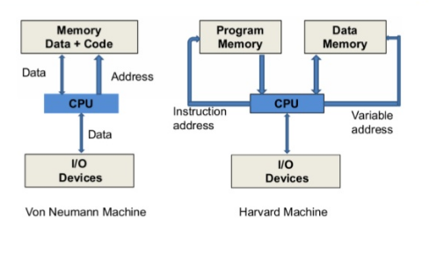
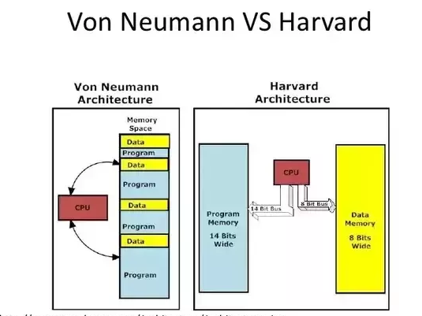
Harvard vs Von Neumann Architecture: Hardware
 | Von Neumann Architecture | Harvard Architecture
Memory layout | Program code(instructions) and data in same space | Instructions and Data in seperate place
# of system busses | 1 | 2
Advantages | Cheaper and simpler to design(less lil wires causing heat and to fit into design) Data and program memory can use space the other is not taking up Self modifying code | Faster, 2 busses allow both a data and instruction address to be read and/or written into per cycle
Disadvantages | Only one data or instruction address read and/or written into per cycle Self modifying code | Needs more space to fit extra bus and extra heat. More expensive and complicated to design Data and program memory cannot use space the other is not taking up
Notes:
n

Slide 4
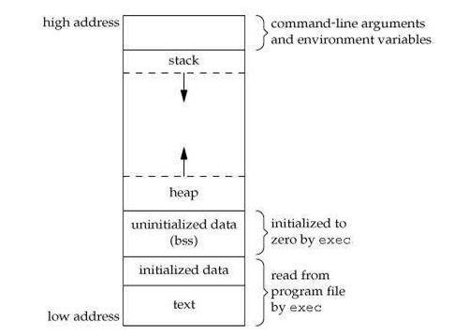
Von Neumann Architecture: Where does the code go?
MP1
Architecture of intel x86 processors
Instructions and data can be accessed (hence self modifying code)
All memory in one index-able space
Text stores compiled program instructions
Data section stores global variables
Stack stores local variables and function arguments. Also saves values needed when returning from a function call
Stack set up when program is compiled. Program depends on stack so we cannot just change it up or there might be side effects.. Stack room more limited as well.
Heap stores dynamically allocated variables (malloc)
In C, if you don’t know how big an array is going to be or might want to add to it, we can use pointers and through malloc store it on the heap. We can call free to free it up. (Similar to java but it does the malloc-ing for us).
-https://www.hackerearth.com/practice/notes/memory-layout-of-c-program/

Slide 5
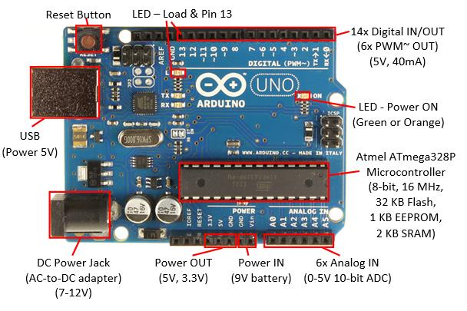
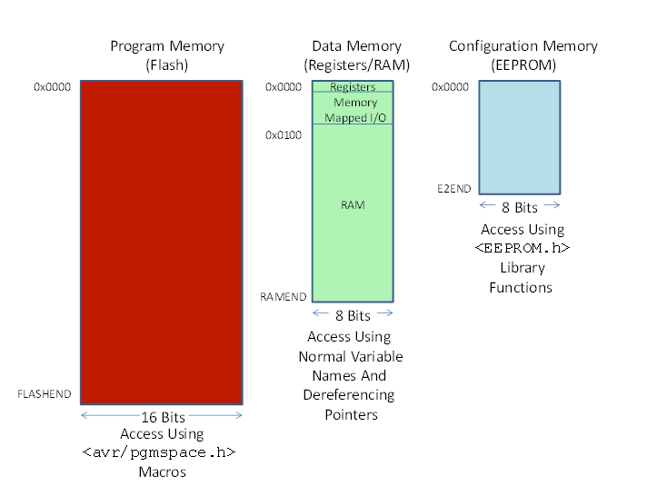
Today’s Lab : Harvard Architecture: Where does the code go?
Architecture of ATmega328P microcontroller. The heart of the Arduino Uno R3.
Memory spaces small as they have to fit in Microcontroller. Only memory stored in computer cpu are the registers.
Bigger than typical cpu chip, room for multiple busses
Configuration memory (EEPROM) 1K bytes or 0.000001 gb :
Non volatile.
Read or written into from program
Slower than ram cause we can only read it and write to it byte by byte
Good for long term storage, like settings or if running out of ram
Program Memory (Flash) 32 K bytes:
Sketch of program/program instructions stored here
We can execute from it but can’t modify data (though we can create constant variables in it with a keyword). The different busses make it harder to access program instructions through code as we are set up to talk to ram
Non volatile

Slide 6
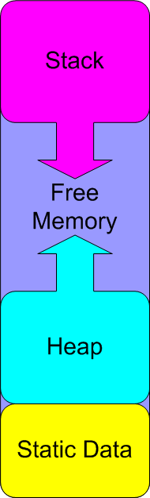
Today’s Lab : Harvard Architecture: Where does the code go?: continued.
Data Memory (Registers/Ram)
Static data. Global variables and variables with initial values. Serial.print(“u up?”) stores string literal “”u up?” here and points to it from program memory to execute..
Heap. For items dynamically placed here, grows up ram.
Stack, for local variable and preserving values across function calls. Grows down towards lower addresses
Volatile
Fastest memory
0x100

Slide 7
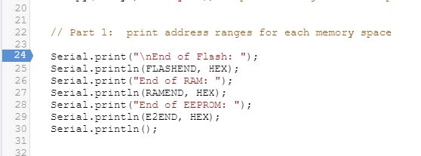
Today’s lab: part 1
The Arduino Language has symbolic constants that hold the last address on all 3 separate chips
FLASHEND, RAMEND, E2END

Slide 8
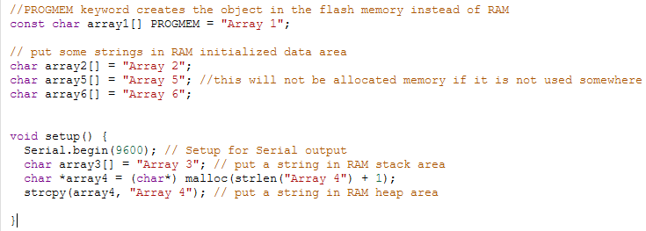
Today’s lab: part 2 : Let’s take a closer look at Ram
Through these arrays, we will piece together the ram.
Find out general locations of the stack, heap, and initialized data all located between 0x100 and RAMEND
Note, array 1 is not in RAM

Slide 9
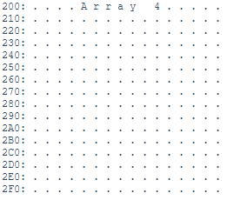
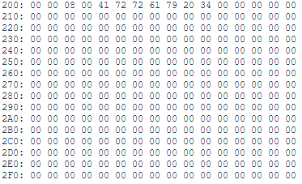
Today’s lab: part 3:
An even more intimate look at the Ram
Ran with hex set to false
We might as wellll comb through it and determine some rough boundaries at this point .
2 functions have been created so you can realllllly see it in hex digits (true) or ascii chars (false).
void displayRAM(char *start, char *endd, bool hex)
displayRAM(char *) 0x000, (char *) 0x200, false) will show us the contents of RAM between 0x000-0x200 in characters where possible and ‘.’ when not printable.
void displayAllRAM(int waitTime, bool hex)
displayAllRAM(2000, true) will show us all RAM in 0x100 blocks with a 2 second delay
Things to consider: Initialized Data, Heap, and the stack will have empty spaces in between them unless one is full (nothing will be full today).
The serial monitor can not be scrolled through.
There are lots of nice comments in the code to help explain what’s happening, though don’t hesitate to ask me if you are stuck
Ran
with
hex set
to
true

